Slide 1
Starting to program – an introduction to Assembly Language
Lecture 5

Slide 2
In this lecture
The difference between High-Level and Low-Level programming languages
What is and why assembly language
Writing in Assembler
Writing our first (Simple) Assembly language program in MPLAB

Slide 3
High-Level Language
Most programming nowadays is done using so-called “high-level” languages (such as C, C++, JAVA, Python, etc.)
These languages deliberately “hide” from a programmer many details concerning HOW his problem actually will be solved by the underlying computing machinery
Source: https://slideplayer.com/slide/5219000/

Slide 4
The BASIC language
Some languages allow programmers to forget about the computer completely!
The language can express a computing problem with a few words of English, plus formulas familiar from high-school algebra.
EXAMPLE PROBLEM: Compute 4 plus 5
Source: https://slideplayer.com/slide/5219000/

Slide 5
The example in BASIC
LET X = 4
LET Y = 5
LET Z = X + Y
PRINT X, “+”, Y, “=“, Z
END
Output: 4 + 5 = 9
Source: https://slideplayer.com/slide/5219000/

Slide 6
computer scientist vs. programmer
But computer scientists DO want to know how computers actually work:
-- so, we can fix computers if they break
-- so, we can employ optimum algorithms
-- so, we can predict computer behavior
-- so, we can devise faster computers
-- so, we can build cheaper computers
-- so, we can pick one suited to a problem
Source: https://slideplayer.com/slide/5219000/

Slide 7
A machine’s own language
For understanding how computers work, we need familiarity with the computer’s own language (called “machine language”)
It’s LOW-LEVEL language (very detailed)
It is specific to a machine’s “architecture”
It is a language “spoken” using voltages
Humans represent it with zeros and ones
For more details, please visit the link below:
http://www.teach-ict.com/as_as_computing/ocr/H447/F453/3_3_8/features/miniweb/index.htm

Slide 8
Example of machine-language
Here’s what a program-fragment looks like:
10100001 10111100 10010011 00000100
00001000 00000011 00000101 11000000
10010011 00000100 00001000 10100011
11000000 10010100 00000100 00001000
It means: z = x + y;

Slide 9
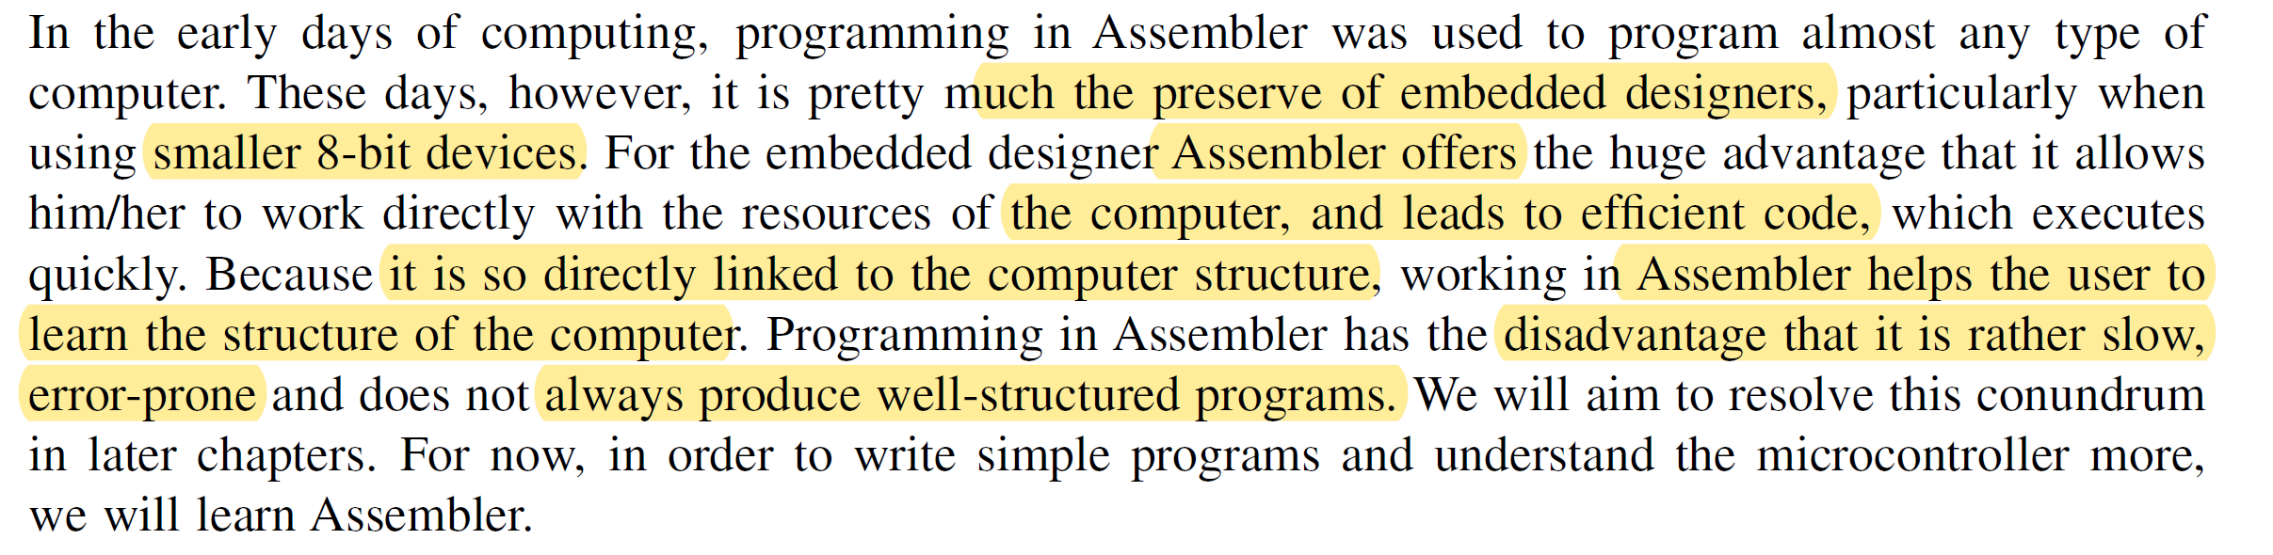
Hence assembly language

Slide 10
The Problem of Programming, and Programming Options
Shall I
compare
Use Assembler
11010010
thee
to a
01010010
summer
11010101
day........?
01001011
01100011
....
Use Machine Code
Use High Level Language
What options do we have for programming a microcontroller?

Slide 11
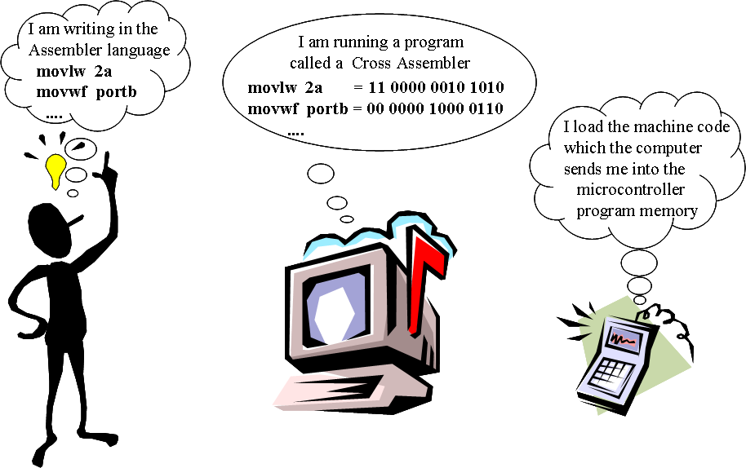
The Assembler Option

Slide 12
Human-Readable Machine Language
0001110010000110
Computers like ones and zeros…
Humans like symbols…
Assembler is a program that turns symbols into machine instructions.
close correspondence between symbols and instruction set
mnemonics for opcodes
labels for memory locations
Additional operations for allocating storage and initializing data
ADD R6,R2,R6 ; increment index reg.

Slide 13
Mnemonics
There are two key ideas:
mnemonic opcodes: we use abbreviations of English language words to denote operations.
Mnemonics are a set of readily memorized programming instructions that are later translated into pure machine code by a piece of software called an 'assembler’.
MOV AL, 32h
The command is instructing the CPU to load 32 hex immediately into a register called AL. It is common practice for the CPU registers to have a two or three letter name.
Source: https://slideplayer.com/slide/5219000/

Slide 14
Instruction set
Assembly language consists of a set of mnemonics that can be used to program a CPU.
There are several mnemonics that together make up the complete instruction set of the CPU. They can be grouped according to the kind of processing they cover.
For example, in the Intel 80186 instruction set some of the mnemonics are
Arithmetic mnemonics : ADD, SUB, DIV, MUL
Data transfer mnemonics: MOV, POP, IN, OUT
Logic mnemonics : AND, OR, XOR, NOT
Jump mnemonics : JMP, JZ (jump if zero)
Miscellaneous mnemonics : NOP (Do nothing for a bit)
One of the skills in writing assembly code is to become familiar with the instruction set of the target CPU.

Slide 15
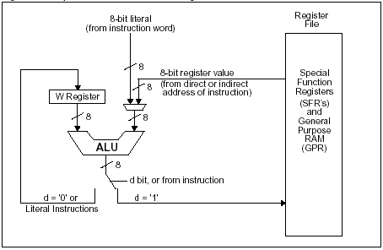
The PIC 16 Series ALU
f for file (i.e. memory location in RAM), a 7-bit number;
b for bit, to be found within a file also specified, a single bit;
d for destination, as described above, a single bit;
k for literal, an 8-bit number if data, or 11-bit if address

Slide 16
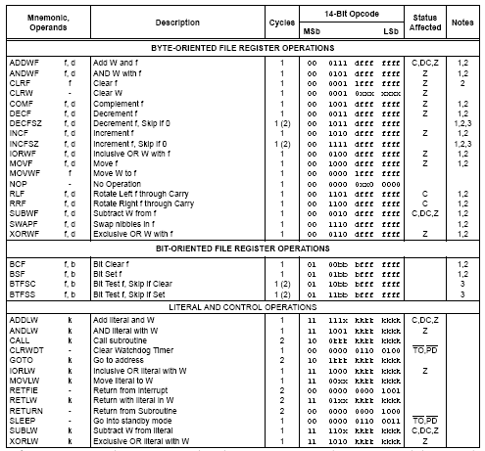
The PIC
16 Series Instruction Set

Slide 17
Some Example Instructions
clrw clears the value in the W register to zero. There are no operands to specify. Column 5 tells us that the Status register Z bit is affected by the instruction. As the result of this instruction is always zero, the bit is always set to 1. No other Status register bits are affected.
clrf f clears the value of a memory location, symbolised as f. It is up to the programmer to specify a value for f, which needs to be a valid memory address. Again, because the result is zero, the Status register Z bit is affected.
addwf f,d adds the contents of the W register to the contents of a memory location symbolised by f. There is a choice of where the result is placed, determined by the value of the operand bit d. Because of the different values that the result can take, all three condition code bits, i.e. Z, C, and DC are affected by the instruction.
addlw k adds a literal, i.e. an 8-bit number written into the program and represented by k, to the value held in the W register. Like the addwf instruction, The Z, C, and DC Status register bits can all be affected by the instruction.
bcf f,b clears a single bit in a memory location, symbolised by f. The bit number b will take a value from 0 to 7, to identify any one of the 8 bits in a memory location. No Status register flags are affected, even though it is possible to imagine that the result of the instruction could be to set a memory location to zero.
goto k This instruction causes the program execution to jump to another point in the program, whose address is given by the constant k. It is up to the programmer to give a value for k. No Status bits are affected.

Slide 18
Opcodes and Operands
Opcodes (An opcode is short for 'Operation Code'.)
reserved symbols that correspond to instructions
( ADD, AND, MOV, BSF, …)
ex: MOV AL, 34h
The opcode is the MOV instruction. The other parts are called the 'operands'.
Operands
Operands are manipulated by the opcode.
In the given example, the operands are the register named AL and the value 34 hex.
Source: http://www.teach-ict.com/as_as_computing/ocr/H447/F453/3_3_8/features/miniweb/pg4.htm

Slide 19
Symbolic addressing
Another key aspect of programming is to fetch or store data and instructions from memory.
The simplest way to do this is to refer directly to a memory location such as #3001. However, it is difficult to see the meaning of the data in location #3001.
symbolic addresses: we invent “meaningful” names for memory storage locations we need
DIAM | EQU 2 | define a constant called diam

Slide 20
Developing a Simple Project
Write/modify Source Code
Assemble/Compile
(Simulate)
Download
Test in Hardware

Slide 21
Assembly Language Syntax
Whitespace (between symbols) and case are ignored.
Comments (beginning with “;”) are also ignored.
An instruction has the following format:
Each line of a program is one of the following:
An instruction
An assember directive (or pseudo-op)
A comment
LABEL OPCODE OPERANDS ; COMMENTS
optional
mandatory

Slide 22
Writing in Assembler
Left-most space
Assembler format:
label instruction operand(s) ;comment
optional
For example:
label
comment
instruction
comment
;now switch on red led
Start bsf status,5 ;select memory bank 1
addwf counter
operands

Slide 23
Assembler Directives
These look like Assembler mnemonics but are instructions to the (Cross-) Assembler program itself. They differ from one Assembler to the other.
Example MPASM assembler Directives
Assembler Directive | Summary of Action
list | implement a listing option*
#include | include additional source file
org | set program origin
equ | define an assembly constant; this allows us to assign a value to a label
end | end program block

Slide 24
Representing Numbers
Radix | Example Representation
Decimal | D‘255’
Hexadecimal | H‘8d’ or Ox8d
Octal | O‘574’
Binary | B‘01011100’
ASCII | ‘G’ or A‘G’

Slide 25
Assembler File Structure (Simple Form)
Files that the Assembler (e.g. MPLAB) generates
For us, this will be MPLAB
Executable File
.hex
Source File
Assembler
List File
.asm
.lst
Written by you, as a text file, in Assembler format
Error File
.err

Slide 26
A First Program
;******************************************************************
;Very first program
;This program repeatedly adds a number to the Working Register.
;TJW 1.11.08 Tested 1.11.08
;******************************************************************
;
; use the org directive to force program start at reset vector
org 00
;program starts here
clrw ;clear W register
loop addlw 08 ;add the number 8 to W register
goto loop
end ;show end of program with "end" directive

Slide 27
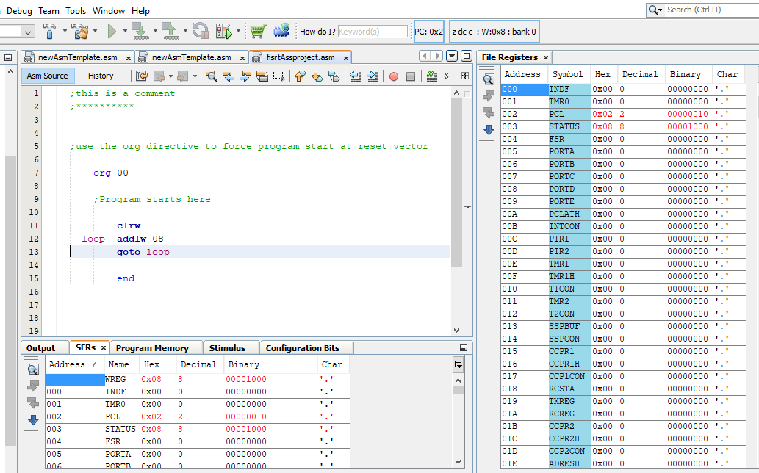
Introducing MPLAB
Continue here with the MPLAB tutorial from page 86 of the book.

